Slide 1
Chapter 18
Nonparametric Tests
Tests for Ordinal Data

Slide 2
Chapter Outline
Tests for Ordinal Data
The Sign Test
The Normal Approximation for the Sign Test
The Wilcoxon Signed-Ranks T Test
The Mann-Whitney U Test
The Kruskal-Wallis H Test
The Friedman Test
APA in Focus: Reporting the Nonparametric Tests

Slide 3
Tests for Ordinal Data (cont.)
Ranked data, which is an ordinal scale measurement, do not convey the distance between scores; the data only indicate that one score is larger or smaller than another
The variance can’t be used to analyze data on an ordinal scale
An additional concern when measuring ordinal data is tied ranks
Suppose we record four ranks: 1, 2, 2, and 3
To avoid bias, average the tied ranks
1. Assume the ranks are in order. Treat tied ranks as if they are not tied
2. Compute the means of the tied ranks
Mean rank =
Replace the tied ranks with this average rank, 2.5
3. Shift the remaining scores accordingly
We averaged ranks 2 and 3. The rank that follows 3 is 4

Slide 4
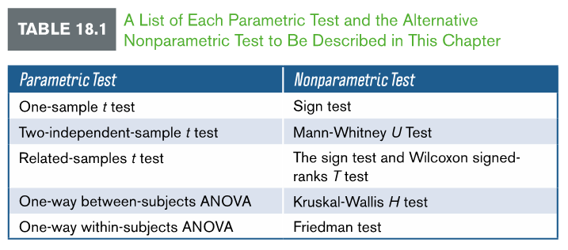
Tests for Ordinal Data

Slide 5
The Sign Test
Sign test – statistical procedure used to determine the binomial probability that an observed number of scores fall above and below the median (one sample) or are positive and negative (related samples). The sign test is used as a nonparametric alternative to the one-independent sample t test and the related samples t test
One-sample sign test
Begin the test by reducing all measures to pluses and minuses
Assign plus sign (+) to any score above the median and assign a negative sign (-) to any score below the median
The test statistic (x) is the number of pluses or minuses, whichever occurs more often
The null is an equal number of scores falling above and below the mean

Slide 6
Example 18.1: One-Sample Sign Test
A researchers finds that the median body mass index (BMI) in the general U.S. population is 28.3. The researcher hypothesizes that professional athletes have lower BMI scores than the general U.S. population and records the BMI scores for six professional athletes, listed in Table 18.2. Conduct a one-sample sign test using a .05 level of significance

Slide 7
Example 18.1: One-Sample Sign Test (cont.)
Step 1: State the hypotheses
H₀ : Median = 28.3 The number of BMI scores above and below 28.3 is the same. No difference in the number of pluses and minuses
H₁ : Median < 28.3 There are more BMI scores below 28.3 than above it. There are more minuses than pluses
Step 2: Set the criteria
Level of significance is .05
n = 6; see Table B.8
If the probability is less than .05, reject the null hypothesis
Step 3: Compute the test statistic
Assign a plus sign to each value above 28.3 and a negative sign to each value below 28.3. Discard any values that equal 28.3
If the hypothesis is true, we should find the same number of pluses and minuses
Test statistic: x = 4 minuses

Slide 8
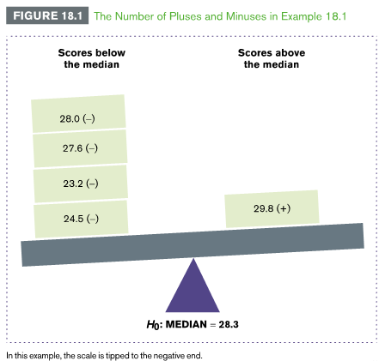
Example 18.1: One-Sample Sign Test (cont.)
Step 4: Make a decision
Find the probability of obtaining at least when
Use the list of binomial probabilities given in Table B8 in Appendix B
The probability of obtaining at least four scores below the median is the sum of the probabilities at , and
p = .344 is larger than .05
Retain the null hypothesis

Slide 9
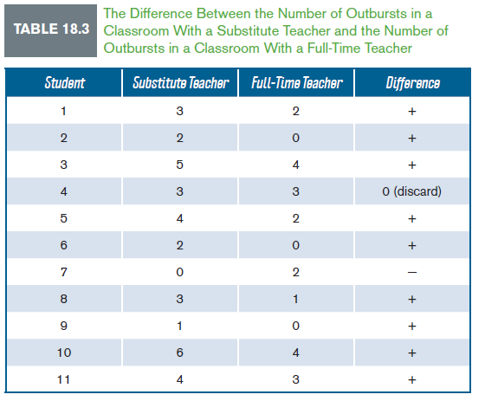
Example 18.2: Related-Samples Sign Test
An instructor notices an increase in student outbursts during class. To test this observation, she compares the difference in the number of student outbursts in a class of 11 students taught by a substitute teacher one day and by a full-time teacher the next day.
Table 18.3 shows the number of outbursts in each class. She hypothesizes that there will be more outbursts in the class taught by the substitute teacher. Conduct the related samples sign test using a .05 level of significance

Slide 10
Example 18.2: Related-Samples Sign Test (cont.)
Step 1: State the hypotheses
H₀ : pluses = Minuses Half the students will show more outbursts in the class taught by the substitute teacher and half will show more outbursts in the class taught by the full-time teacher. The number of pluses and minuses will be the same
H₁ : pluses > Minuses More students will show more outbursts in the class taught by the substitute teacher than in the class taught by the full-time teacher. There will be more pluses than minuses
Step 2: Set the criteria
Level of significance is .05
Test statistic is the number of pluses or minuses, whichever occur more often
Step 3: Compute the test statistic
Subtract across rows in Table 18.3, which lists the pluses and minuses
Assign a plus sign (+) for positive differences and a negative sign (-) for negative differences. Discard 0s
Test statistic: x = 9 pluses

Slide 11
Example 18.2: Related-Samples Sign Test (cont.)
Step 4: Make a decision
Find the probability of obtaining at least when
Use the list of binomial probabilities given in Table B8 in Appendix B
The probability of obtaining at least nine positive scores below the median is the sum of the probabilities at , , and
The missing value for n = 11 is negligible
p = 0.032 is smaller than .05
Reject the null hypothesis

Slide 12
The Normal Approximation for the Sign Test
With larger samples, the binomial distribution approximates a normal distribution
When you have a large sample size, you can approximate the binomial probabilities of the sign test using the following formula:
X is the value of the test statistic, n is the sample size, and p is the probability that we obtain scores above or below the median when the null hypothesis is true
The null hypothesis is that half the scores will be above and half below the median, so p = .50 for this test

Slide 13
The Wilcoxon Signed-Ranks T Test
Wilcoxon signed ranks T test – statistical procedure to determine whether the total ranks in two related groups are significantly different. This test is used as a nonparametric alternative to the related samples t test
To compute the Wilcoxon signed-ranks T test:
Step 1: Rank each difference score regardless of sign
Step 2: Separate the ranks into two groups: those associated with positive differences (+) and those associated with negative differences (-)
Step 3: Sum the ranks in each group. The smaller total is the test statistic (T)

Slide 14
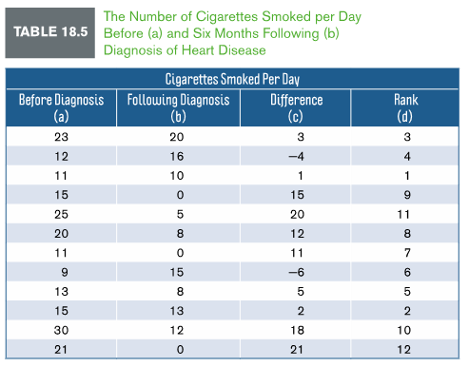
Example 18.3: Wilcoxon Signed-Ranks T Test
A researcher measures the number of cigarettes patients smoked (per day) in a sample of 12 patients before and 6 months following diagnosis of heart disease. Table 18.5 shows the pre- and post diagnosis results. Test whether patients significantly reduced smoking 6 months following diagnosis using the Wilcoxon signed-ranks T test at a .05 level of significance

Slide 15
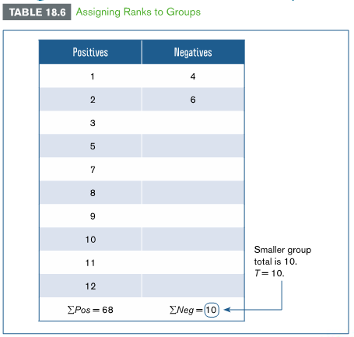
Example 18.3: Wilcoxon Signed-Ranks T Test (cont.)
Step 1: Rank each difference score regardless of sign
Rankings begin with the lowest nonnegative difference score (1) and continue incrementally until all difference scores have been ranked
Step 2: Separate the ranks into two groups
Use the sign of the difference scores in column C to sort ranks into positive and negative groups

Slide 16
Example 18.3: Wilcoxon Signed-Ranks T Test (cont.)
Step 3: Sum the ranks in each group
The smaller total is the test statistic, which in this example is T = 10
Compare the value of T to the critical value listed in Table B.9 in Appendix B
The critical value for a two-tailed test with n = 12 at a .05 level of significance is 13
Compare the value of the test statistic T to the critical value of 13
Because the test statistic (T = 10) is smaller than the critical value, we reject the null hypothesis
See “Table of critical values for the Wilcoxon test-.pdf”

Slide 17
The Wilcoxon Signed-Ranks T Test (cont.)
Interpretation of the Test Statistic T
The smaller the test statistic, the more likely we are to reject the null hypothesis
A smaller value of T reflects larger differences between groups, meaning that smaller values of T are less likely to occur if the null hypothesis is true
The Normal Approximation for the Wilcoxon T
With larger samples, we can use the normal approximation of the Wilcoxon signed-ranks T test to find the probability of obtaining the test statistic T
When the null hypothesis is true, the test statistic has a mean and SD equal to:
Mean =
SD =
The test statistic corresponds to a z distribution:

Slide 18
The Mann-Whitney U Test
Mann-Whitney U test – statistical procedure used to determine whether the dispersion of ranks in two independent groups is equal. The Mann-Whitney U test is used as a nonparametric alternative to the two-independent sample t test
To compute the Mann-Whitney U test:
Step 1: Combine scores from both samples and rank them in numerical order (keep track of the group that scores came from)
Step 2: Assign points when a score in one group outranks scores in another group
Step 3: Sum the points in each group to find the test statistic (U). The smaller total is the test statistic

Slide 19
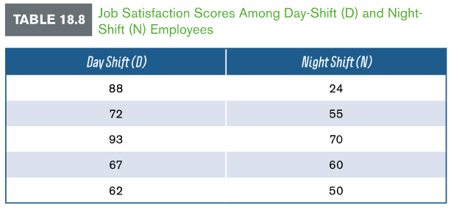
Example 18.4: The Mann-Whitney U Test
A business owner measured the job satisfaction of his day shift and night shift employees. Employees rated their job satisfaction on a rating scale from 1 (not satisfied at all) to 100 (completely satisfied). Table 18.8 lists each worker’s rating. Test whether ratings of job satisfaction differed between these two groups using the Mann-Whitney U test at a .05 level of significance

Slide 20
Example 18.4: The Mann-Whitney U Test (cont.)
Step 1: Combine scores from both samples
Step 2: Award points when a score in one group outranks scores in another group

Slide 21
Example 18.4: The Mann-Whitney U Test (cont.)
Step 3: Sum the points in each group to find the test statistic (U)
Table 18.10 reorganizes the data into groups
Group D was assigned a total of 23 points and group N was assigned 2 points
The smaller total is the test statistic:
Test statistic: U = 2
To decide whether to retain or reject the null hypothesis, compare value of test statistic to the critical value found in Table B.10 in Appendix B
The critical value for U is 2
Because the test statistic (U = 2) is equal to the critical value, reject the null hypothesis
See “Mann-Whitney U Test critical values.pdf”

Slide 22
The Mann-Whitney U Test (cont.)
Interpretation of the Test Statistic U
Smaller values of U are associated with a greater likelihood of rejecting the null hypothesis
Computing the Test Statistic U
When the sample size is large, the test statistic for two independent groups (A and B) can be computed using the following formulas for each group:
Group A:
Group B:
The Normal Approximation for U
With large samples, we can use the normal approximation for the Mann-Whitney U test to find the probability of obtaining the test statistic
When the null hypothesis is true, the mean and SD are equal to:
Mean: SD:
The test statistic corresponds to a z distribution:

Slide 23
The Kruskal-Wallis H Test
Kruskal-Wallis H test – statistical procedure used to determine whether the total ranks in two or more independent groups are significantly different. The Kruskal-Wallis H test is used as a nonparametric alternative to the one-way between-subjects ANOVA
To compute the Kruskal-Wallis H test:
Step 1: Combine scores from each group and rank them in numerical order
Step 2: Sum the ranks for each group
Step 3: Compute the test statistic (H)
Null is that the sum of ranks in each group do not differ; alternative is that they do differ in each group
When the null is true and n is greater than or equal to 5 per group, test statistic is approximately normally distributed as a chi-square with k – 1 degrees of freedom.

Slide 24
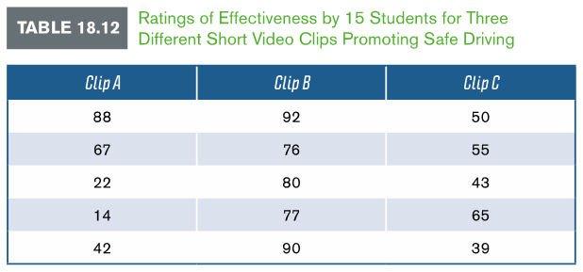
Example 18.5: The Kruskal-Wallis H Test
A researcher asks a sample of 15 students (n = 5 per group) to view and rate how effectively they think one of three short video clips promote safe driving. The participants rated these clips from 1 (not effective at all) to 100 (very effective). Table 18.12 lists the ratings by participants in each group. Test whether ratings differ between groups using the Kruskal-Wallis H test at a .05 level of significance

Slide 25
Example 18.5: The Kruskal-Wallis H Test (cont.)
Step 1: Combine scores from each group and rank them in numerical order
Step 2: Sum the ranks for each group (this will be test statistic)
© 2014 SAGE Publications

Slide 26
Example 18.5: The Kruskal-Wallis H Test (cont.)
Step 3: Compute the test statistic (H)
The formula is:
The test statistic is:
The df are 3 – 1 = 2
Critical value is 5.99
Test statistic 7.28 exceeds 5.99
Reject the null hypothesis
Rankings of three save driving video clips were significantly different
See “KW-expanded-tables-3groups.pdf” for critical values

Slide 27
The Kruskal-Wallis H Test (cont.)
Interpretation of the Test Statistic H
When the null hypothesis is true, the ranks will be evenly distributed between groups
When ranks dispersed unevenly, the total ranks will be very different between groups
The more uneven the dispersion of ranks between two or more independent groups the larger the test statistic. Thus, we are to reject the null hypothesis

Slide 28
The Friedman Test
Friedman test – statistical procedure used to determine whether the total ranks in two or more groups are significantly different when the same participants are observed in each group. The Friedman test is used as a nonparametric alternative to the one-way within-subjects ANOVA
To compute the Friedman test:
Step 1: Rank scores across each row for each individual participant
Step 2: Sum the ranks for each group
Step 3: Compute the test statistic ( )
The null and alternative hypotheses do not differ from Kruskal-Wallis, nor does information regarding sample size per group and normal distribution of data as a chi-square

Slide 29
Example 18.6: The Friedman Test
An obstetrician is concerned that women without health insurance will fail to make regular office visits during the course of their pregnancy. To test this concern, she selects a sample of seven expecting women who do not have health insurance and records the number of hospital visits made during each trimester of their pregnancy. The data are shown in Table 18.15a. Test whether the number of office visits during each trimester of pregnancy is significantly different using the Friedman test at a .05 level of significance

Slide 30
Example 18.6: The Friedman Test (cont.)
Step 1: Rank scores across each row for each individual participant (least to most)

Slide 31
Example 18.6: The Friedman Test (cont.)
Step 2: Sum the ranks for each group
Once all scores are ranked, sum the ranks in each group
In Table 18.15b, this means that you sum down the columns
The sum of ranks will be used to compute the test statistic
Step 3: Compute the test statistic
df are
Critical value is 5.99
Test statistic of 2.658 does not exceed the critical value of 5.99
Retain the null hypothesis
See “Upper Critical Values for the Friedman Test.pdf”

Slide 32
The Friedman Test (cont.)
Interpretation of the Test Statistic
The more consistent the ranks, the larger the differences will be in the total ranks for each group and the more likely we are to reject the null hypothesis
Larger values of reflect larger differences between groups, meaning that larger values of are less likely to occur if the null hypothesis is true

Slide 33
APA in Focus: Reporting the Nonparametric Tests
To summarize any nonparametric test, report the test statistic, df (if applicable), and the p value
df would be applicable for the Friedman test and Kruskal-Wallis H test
The sign test, Wilcoxon signed-ranked T test, and Mann-Whitney U test can be computed two ways because each has a normal approximation alternative with large samples
You can report the original test statistic or the z score for the normal approximation of these tests

Slide 34
APA in Focus: Reporting the Nonparametric Tests
3.9. User preference
“At the end of the experiment, we asked participants to report their opinions on the various texting approaches. Binomial sign tests were used to compare participants’ preferences. Eighteen participants considered manual texting to be the most distracting, while seven considered speech-based texting with the smartphone to be more distracting, p > 0.250.
References:
He, J., Choi, W., McCarley, J. S., Chaparro, B. S., & Wang, C. (2015). Texting while driving using Google Glass™: Promising but not distraction-free. Accident Analysis & Prevention, 81, 218-229.

